Slide 1
Prediction of Protein Tertiary Structure Using PROFESY, a Novel Method Based on Fragment Assembly and Conformational Space Annealing
Julian Lee, Seung-Yeon Kim, Keehyoung Joo,
Ilsoo Kim, and Jooyoung Lee
PROTEINS: Structure, Function, and Bioinformatics 56:704–714(2004)
Speaker: Chun-Jen Chen
Date: Aug. 10, 2009

Slide 2
Abstract
A novel method for ab initio prediction of protein tertiary structures, PROFESY (PROFile Enumerating SYstem), is proposed. This method utilizes the secondary structure prediction information of a query sequence and the fragment assembly procedure based on global optimization. Fifteen-residue-long fragment libraries are constructed using the secondary structure prediction method PREDICT, and fragments in these libraries are assembled to generate full-length chains of a query protein.
115/11/08

Slide 3
Abstract
Tertiary structures of 50 to 100 conformations are obtained by minimizing an energy function for proteins, using the conformational space annealing method that enables one to sample diverse low-lying local minima of the energy. We apply PROFESY for benchmark tests to proteins with known structures to demonstrate its feasibility. In addition, we participated in CASP5 and applied PROFESY to four new-fold targets for blind prediction. The results are quite promising, despite the fact that PROFESY was in its early stages of development. In particular, PROFESY successfully provided us the best model-one structure for the target T0161.
115/11/08

Slide 4
Construction of Fragment Libraries
For a given protein sequence, PREDICT uses a sequence comparison method, PSI-BLAST, to generate its profile, which defines patterns for its amino acid residues.
The fragment library of this residue is the collection of 20 backbone structures of the corresponding 20 nearest patterns in the pattern database of PREDICT.
115/11/08

Slide 5
Energy Function
E = Evdw -100Nhb
Evdw is the Lennard-Jones 6-12 van der Waals energy of the CHARMM forcefield in the TINKER package introduced in order to avoid steric clashes.
Nhb is the number of hydrogen bonds between residues, which are at least five residues apart in sequence.
It should be noted that short-range hydrogen bonds are already favored by the fact that they are present in –helical fragments. Therefore, it is not necessary to include short range hydrogen bond energy terms.

Slide 6
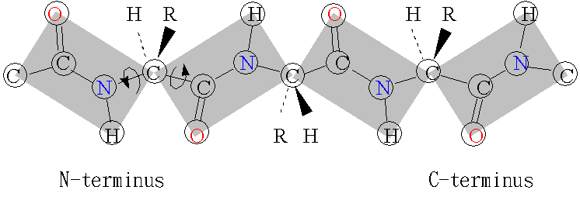
Φ(phi) and Ψ(psi)
Φ
Ψ
115/11/08

Slide 7
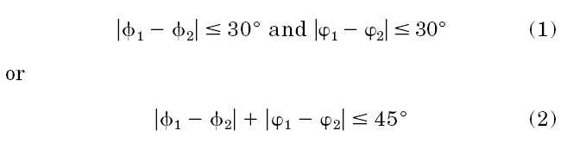
Generation of Random Conformations
SEQLARLKREFNENRYLTERRRQQL
1
2
 |  | K
 | R
 |  | K | R

Slide 8
Fragment Replacement and the Local Minimization of the Energy

Slide 9
Global Search Using Conformational Space Annealing Method
B D(A,B) < D_{cut}
A

Slide 10
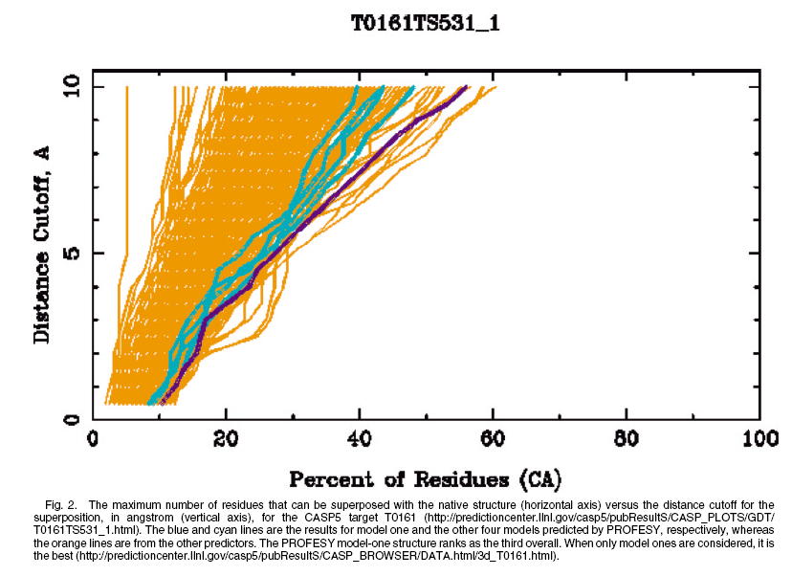

Slide 11
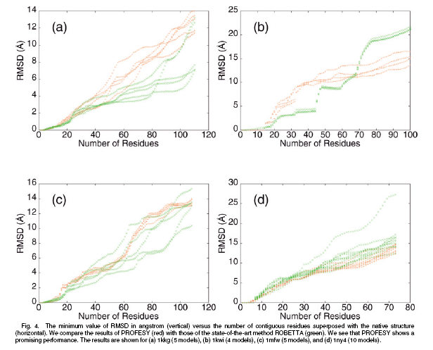

Slide 12
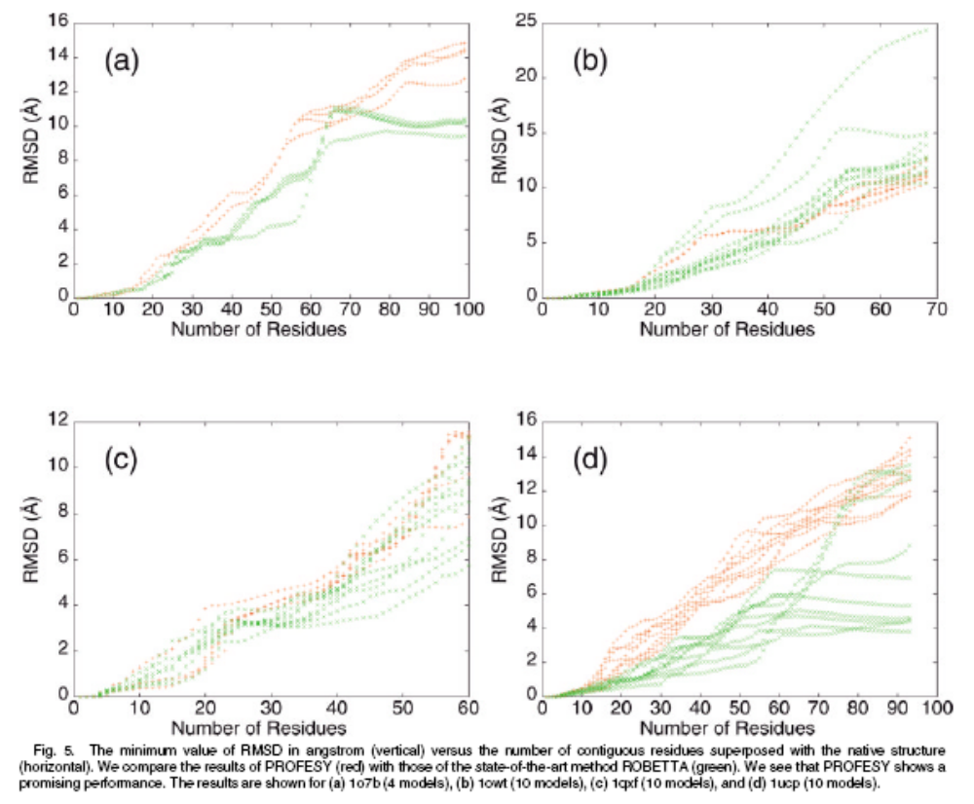

Slide 13
Discussion
Although ROBETTA outperforms PROFESY in six out of eight cases, the overall performance of PROFESY is quite promising, considering the fact that the energy and score functions used in PROFESY are still in their early stages of development.

